Slide 1

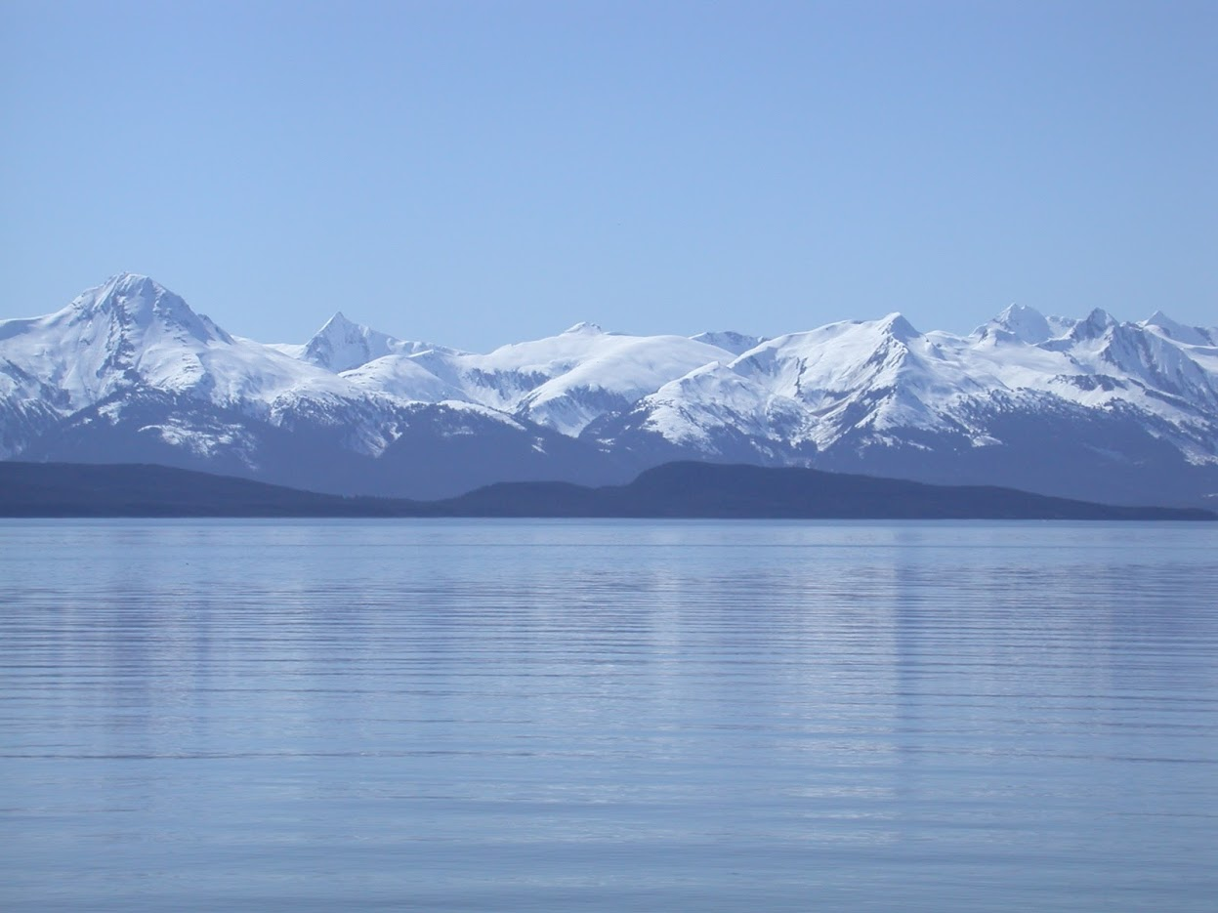


Flathead Sole
GOA Groundfish Plan Team
Maia Sosa Kapur
Cole Monnohan
November 2022

Slide 2
Stock Overview
Tier: 3a
Area: Eastern Bering Sea (EBS) and Aleutian Islands (AI)
Current year status
BRIEF summary of changes to the current assessment data/model

Slide 3
Teams or SSC Comments
The SSC notes that model fits to the female fishery composition data are poor and looks forward to investigations on data quality issues as they relate to sample size and speciation issues associated with the compositional information.
Answer:
The SSC recommends that the authors check the parameterization for selectivity of the shelf survey to verify that the peaks of the domed shape failing to reach a value of 1.0 does not create any unexpected artifacts or change the interpretation of catchability.
Answer:
SSC requests the authors bring forward historical information on the rationale used for the selectivity parameterizations used in the assessment.
Answer:
Notes:
PT/SSC comments being addressed IN THIS PRESENTATION ONLY

Slide 4
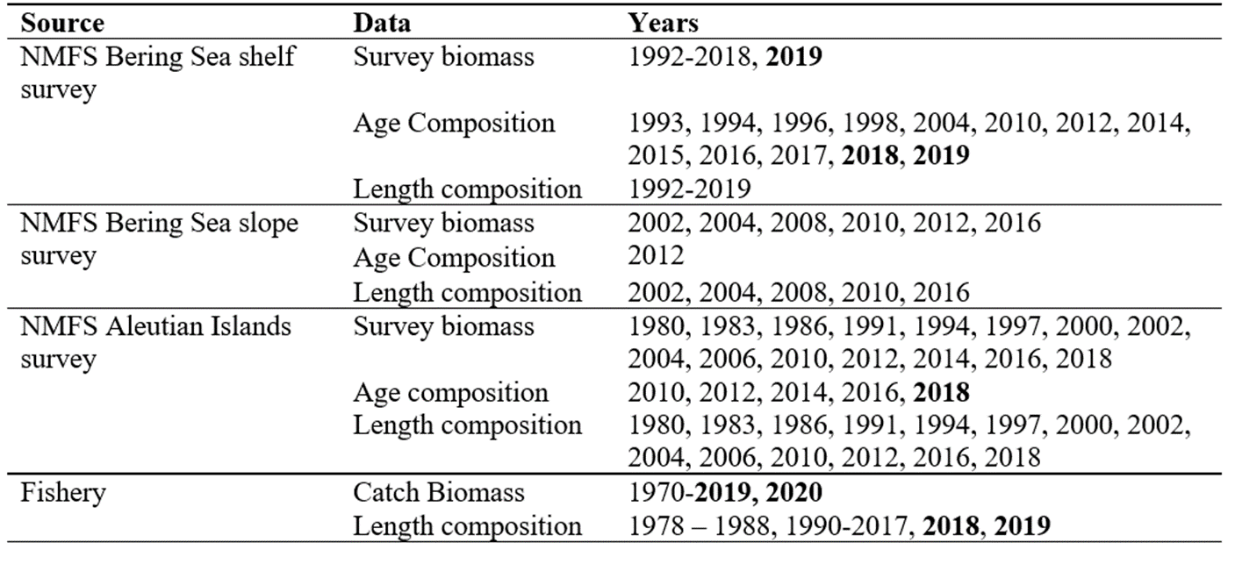
Data Summary
Notes:
Time series graph or table of data used in the model, specify years (try to avoid presenting data not used in the model unless presented to provide support for model evaluation)

Slide 5
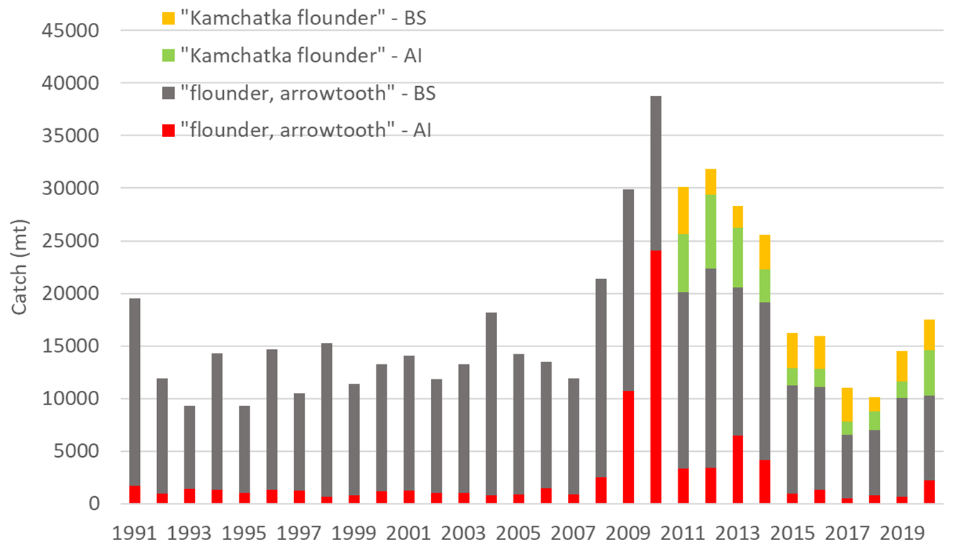
Catch
Notes:
Time series with highlights of trends and any issues (e.g., overages, data issues, discards), provide regional breakdown time series or spatial distribution maps only if relevant to data interpretation or model evaluation

Slide 6
Fishery Age Composition
Graphs of age compositions by sex (if relevant) over time followed by size compositions by sex (if relevant) over time with highlights of trends and any issues (e.g., tracking cohorts through time, shifts in size distributions, plus age group)
Notes:
Graphs of age compositions by sex (if relevant) over time followed by size compositions by sex (if relevant) over time with highlights of trends and any issues (e.g., tracking cohorts through time, shifts in size distributions, plus age group)

Slide 7
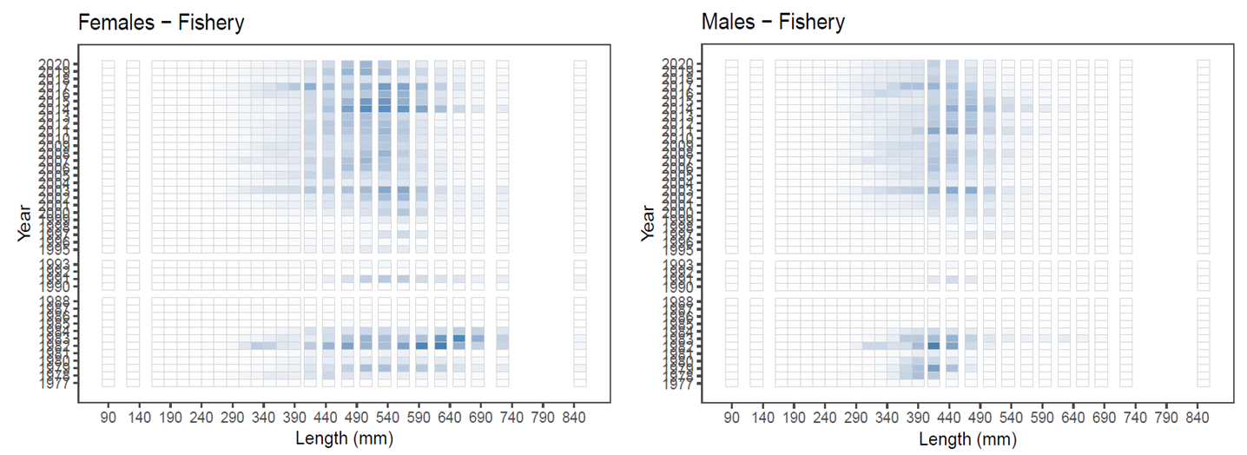
Fishery Size Composition
Notes:
Graphs of age compositions by sex (if relevant) over time followed by size compositions by sex (if relevant) over time with highlights of trends and any issues (e.g., tracking cohorts through time, shifts in size distributions, plus age group)

Slide 8
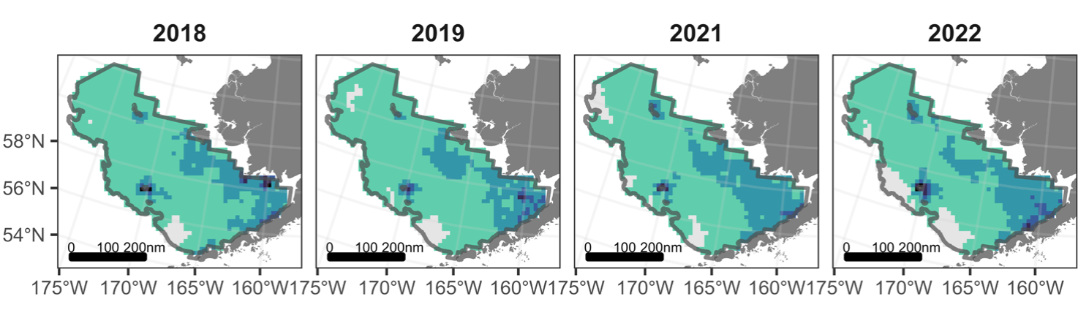
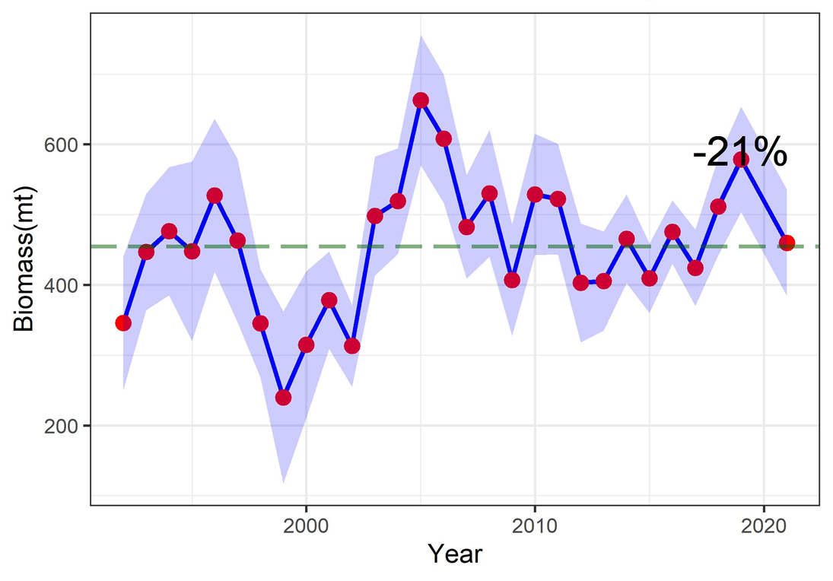
Survey - EBS Shelf Bottom Trawl
Notes:
Time series with highlights of trends and any issues (e.g., survey method changes, data issues), use separate slides for different survey time series, provide regional breakdown time series or spatial distribution maps only if relevant to data interpretation or model evaluation, may include exploratory surveys if relevant to model interpretation, otherwise limit

Slide 9
Survey Age Composition - EBS Shelf Bottom Trawl
Graphs of age compositions by sex (if relevant) over time followed by size compositions by sex (if relevant) over time with highlights of trends and any issues (e.g., tracking cohorts through time, shifts in size distributions, plus age group)
Notes:
Graphs of age compositions by sex (if relevant) over time followed by size compositions by sex (if relevant) over time with highlights of trends and any issues (e.g., tracking cohorts through time, shifts in size distributions, plus age group)

Slide 10
Survey Size Composition - EBS Shelf Bottom Trawl
Graphs of age compositions by sex (if relevant) over time followed by size compositions by sex (if relevant) over time with highlights of trends and any issues (e.g., tracking cohorts through time, shifts in size distributions, plus age group)
Notes:
Graphs of age compositions by sex (if relevant) over time followed by size compositions by sex (if relevant) over time with highlights of trends and any issues (e.g., tracking cohorts through time, shifts in size distributions, plus age group)

Slide 11
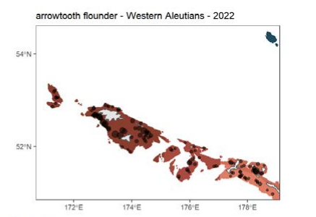
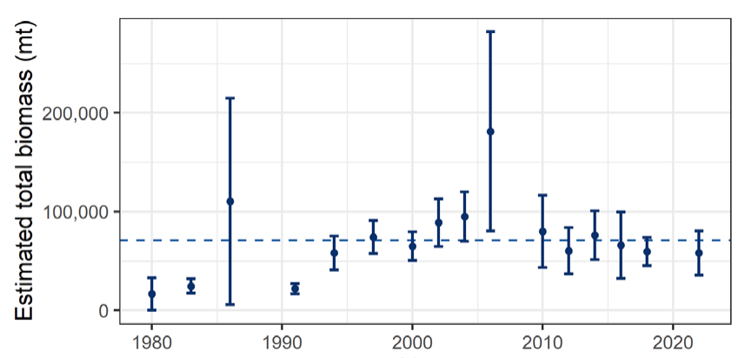
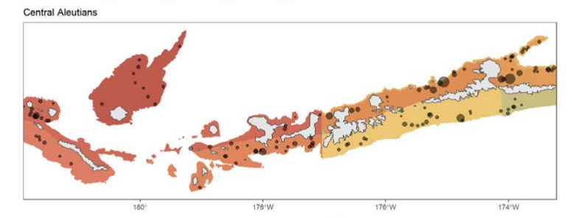
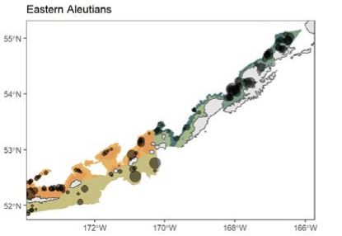
Survey - Aleutian Islands Bottom Trawl
Notes:
Time series with highlights of trends and any issues (e.g., survey method changes, data issues), use separate slides for different survey time series, provide regional breakdown time series or spatial distribution maps only if relevant to data interpretation or model evaluation, may include exploratory surveys if relevant to model interpretation, otherwise limit

Slide 12
Survey Age Composition - AI Bottom Trawl
Graphs of age compositions by sex (if relevant) over time followed by size compositions by sex (if relevant) over time with highlights of trends and any issues (e.g., tracking cohorts through time, shifts in size distributions, plus age group)
Notes:
Graphs of age compositions by sex (if relevant) over time followed by size compositions by sex (if relevant) over time with highlights of trends and any issues (e.g., tracking cohorts through time, shifts in size distributions, plus age group)

Slide 13
Survey Size Composition - AI Bottom Trawl
Graphs of age compositions by sex (if relevant) over time followed by size compositions by sex (if relevant) over time with highlights of trends and any issues (e.g., tracking cohorts through time, shifts in size distributions, plus age group)
Notes:
Graphs of age compositions by sex (if relevant) over time followed by size compositions by sex (if relevant) over time with highlights of trends and any issues (e.g., tracking cohorts through time, shifts in size distributions, plus age group)

Slide 14
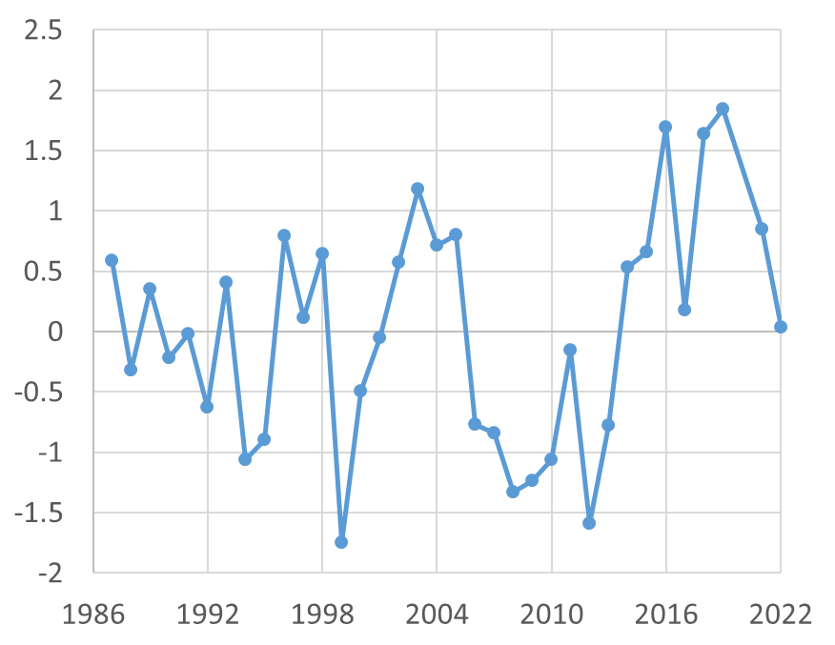
Bottom Temperature
EBS Shelf Bottom Temperature
Some of annual variability in arrowtooth biomass seemed to co-vary with bottom temperature
Use bottom temperature anomalies to estimate time-varying annual catchability on the shelf survey
Trends
Temperature anomaly has been positive since 2014 (marine heatwave)
Near average in 2022
Notes:
Time series if used in the model with explanation of how used

Slide 15
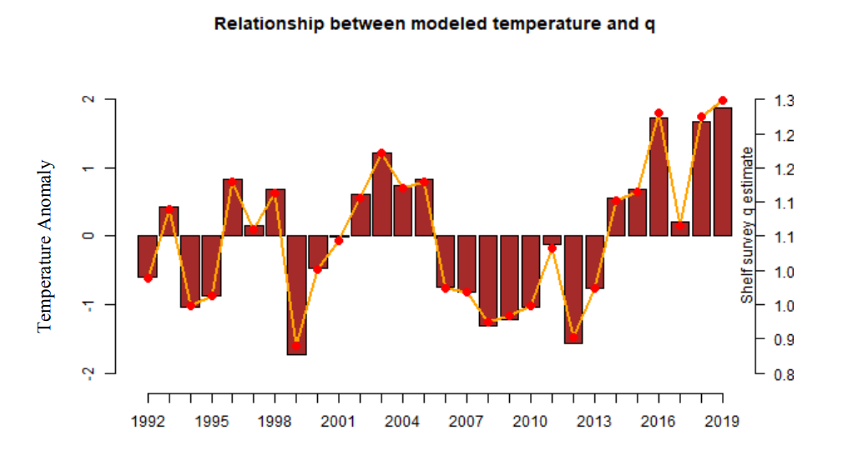
Parameters Estimated Externally
Notes:
List or table with estimates with highlights of trends and any issues (e.g., different natural mortality estimates, changes in maturity)

Slide 16
Model Summary
No Model Changes
Same model as 2018, see Spies et al. 2018 for more details
Split-sex, age structured model…
Notes:
Table of base model with brief description of features and list of alternative models if relevant, NOTE: do not show models not being evaluated

Slide 17
Model Results
Model Fit
Parameters
Selectivity
Time Series
Retrospective
Phase Plane
Risk Table
Projections
Management
Notes:
Outline list of results section including Model Fit, Parameters, Selectivity, Time Series, Retrospective, Phase Plane, Risk Table, Projections, Management

Slide 18
Model Fit - Catch
Should include graphs of model fit to time series and compositions shown in the Data Summary section, preferably in the same order (e.g., Model Fit - Catch, then Model Fit - Fishery Age Composition,...), may include convergence or goodness of fit statistics, if evaluating multiple models show fit of all models evaluated for time series and compositions, highlight any lack of fit, may provide likelihood comparison table
Notes:
Should include graphs of model fit to time series and compositions shown in the Data Summary section, preferably in the same order (e.g., Model Fit - Catch, then Model Fit - Fishery Age Composition,...), may include convergence or goodness of fit statistics, if evaluating multiple models show fit of all models evaluated for time series and compositions, highlight any lack of fit, may provide likelihood comparison table

Slide 19
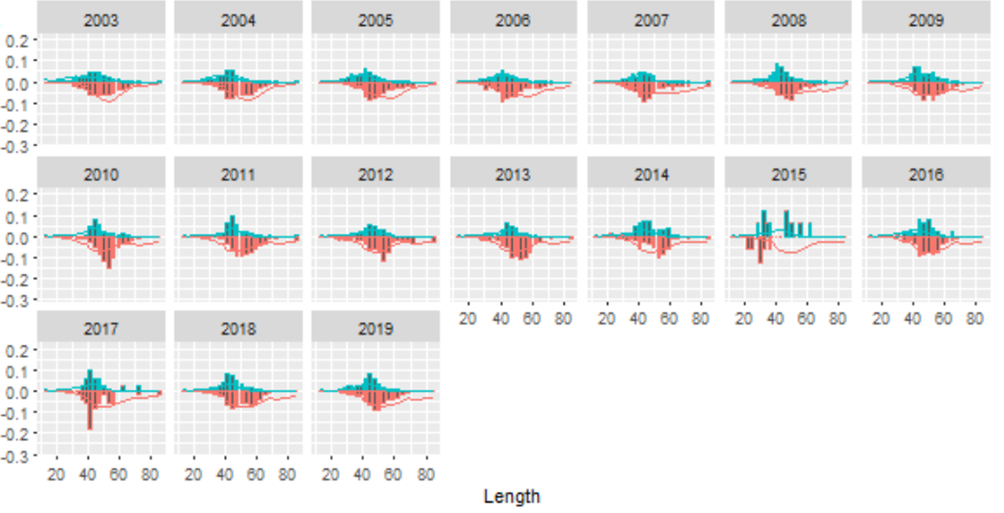
Model Fit - Fishery Size Composition
Notes:
Should include graphs of model fit to time series and compositions shown in the Data Summary section, preferably in the same order (e.g., Model Fit - Catch, then Model Fit - Fishery Age Composition,...), may include convergence or goodness of fit statistics, if evaluating multiple models show fit of all models evaluated for time series and compositions, highlight any lack of fit, may provide likelihood comparison table

Slide 20
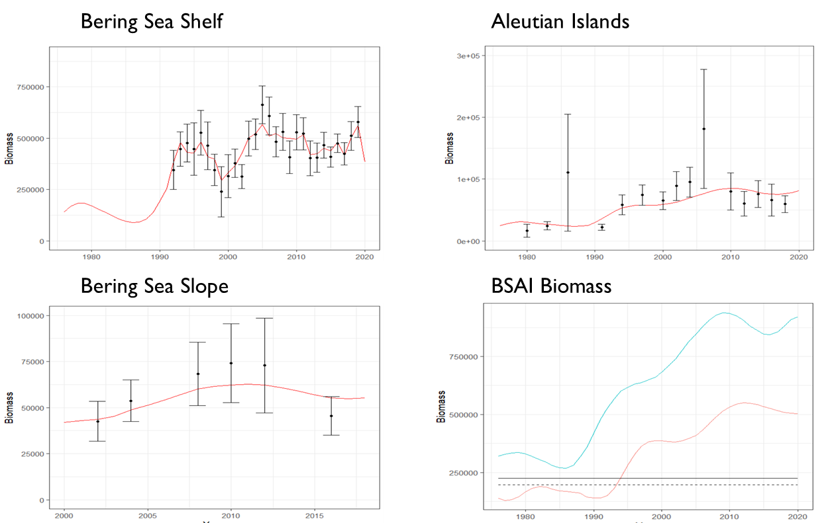
Model Fit - Survey Biomass
Notes:
Should include graphs of model fit to time series and compositions shown in the Data Summary section, preferably in the same order (e.g., Model Fit - Catch, then Model Fit - Fishery Age Composition,...), may include convergence or goodness of fit statistics, if evaluating multiple models show fit of all models evaluated for time series and compositions, highlight any lack of fit, may provide likelihood comparison table

Slide 21
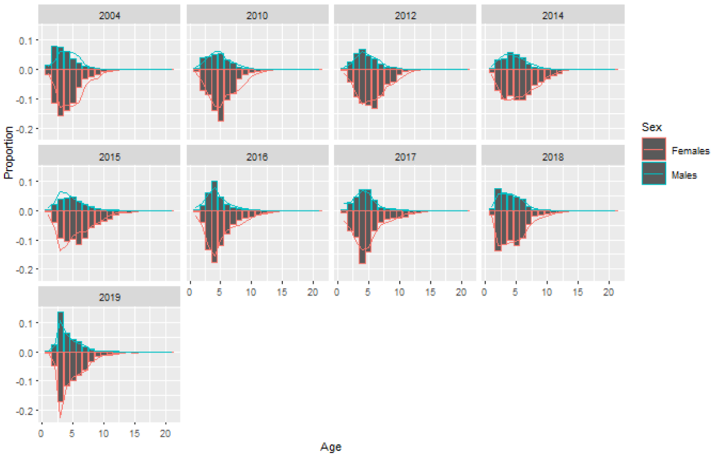
Model Fit - Survey Age Composition - EBS Shelf Survey
Notes:
Should include graphs of model fit to time series and compositions shown in the Data Summary section, preferably in the same order (e.g., Model Fit - Catch, then Model Fit - Fishery Age Composition,...), may include convergence or goodness of fit statistics, if evaluating multiple models show fit of all models evaluated for time series and compositions, highlight any lack of fit, may provide likelihood comparison table

Slide 22
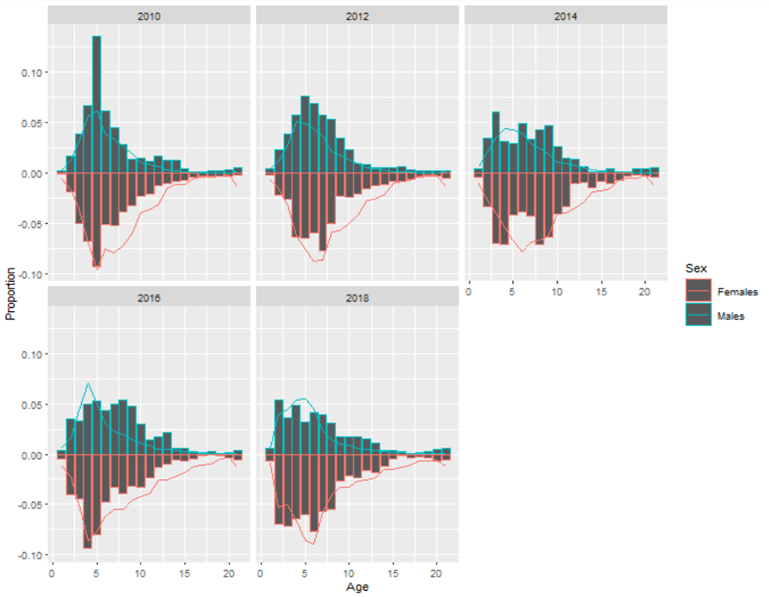
Model Fit - Survey Age Composition - AI Survey
Notes:
Should include graphs of model fit to time series and compositions shown in the Data Summary section, preferably in the same order (e.g., Model Fit - Catch, then Model Fit - Fishery Age Composition,...), may include convergence or goodness of fit statistics, if evaluating multiple models show fit of all models evaluated for time series and compositions, highlight any lack of fit, may provide likelihood comparison table

Slide 23
Parameters
Comparison table of main estimated parameters with uncertainty estimates, if evaluating multiple models provide parameter estimates for all models evaluated, highlight author recommended model
Notes:
Comparison table of main estimated parameters with uncertainty estimates, if evaluating multiple models provide parameter estimates for all models evaluated, highlight author recommended model

Slide 24
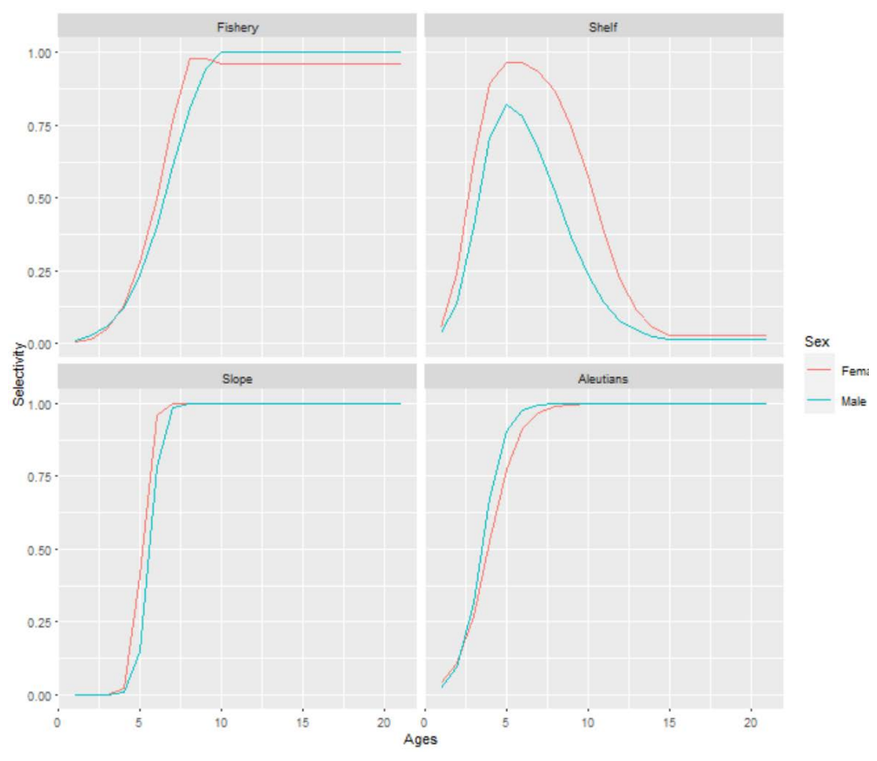
Selectivity
Notes:
Graphs of estimated selectivity curves (e.g., fishery, survey, maturity), if evaluating multiple models include selectivity curves for all models evaluated on same graph if possible, highlight author recommended model

Slide 25
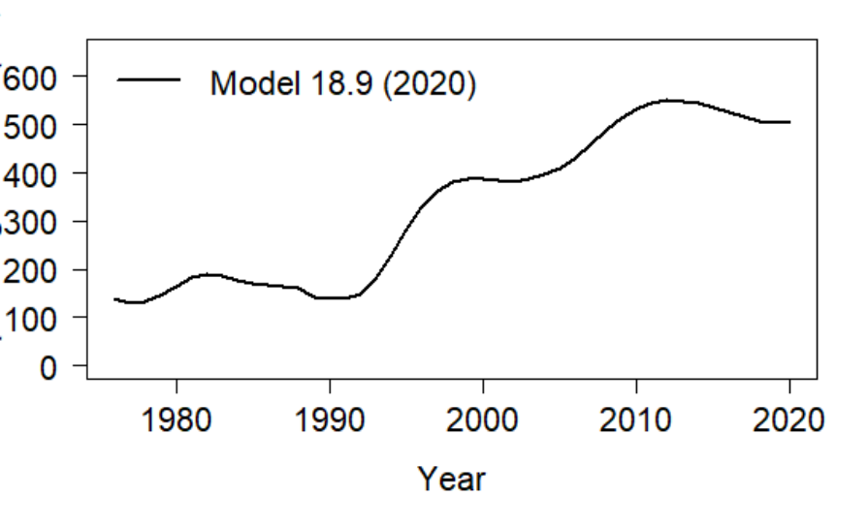
Time Series - Spawning Stock Biomass
Notes:
Graph to include at minimum estimates of Spawning Stock Biomass, Total Biomass, Recruitment, Fishing Mortality (e.g., Time Series - Spawning Stock Biomass), if evaluating multiple models include time series for all models evaluated on same graph, highlight author recommended model

Slide 26
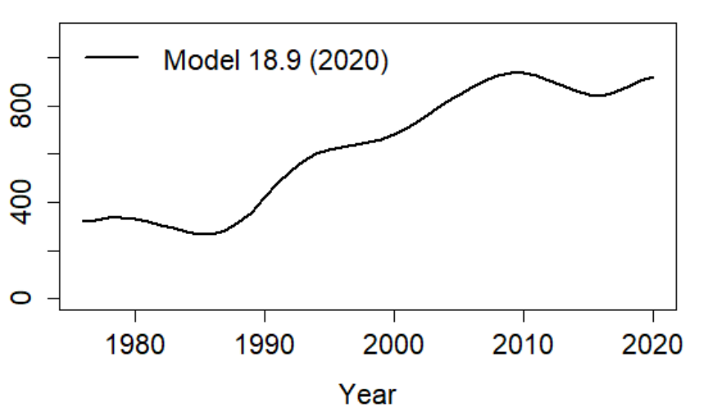
Time Series - Total Biomass
Notes:
Graph to include at minimum estimates of Spawning Stock Biomass, Total Biomass, Recruitment, Fishing Mortality (e.g., Time Series - Spawning Stock Biomass), if evaluating multiple models include time series for all models evaluated on same graph, highlight author recommended model

Slide 27
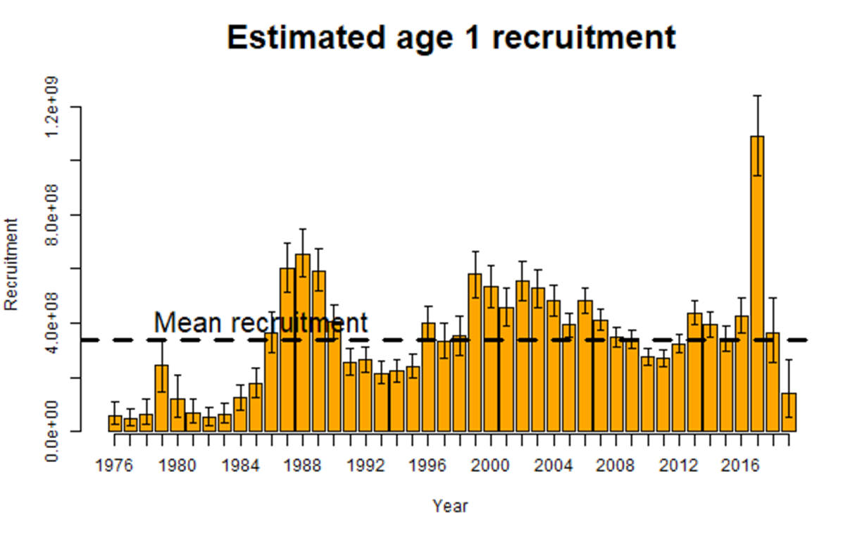
Time Series - Recruitment
Notes:
Graph to include at minimum estimates of Spawning Stock Biomass, Total Biomass, Recruitment, Fishing Mortality (e.g., Time Series - Spawning Stock Biomass), if evaluating multiple models include time series for all models evaluated on same graph, highlight author recommended model

Slide 28
Time Series - Fishing Mortality
Graph to include at minimum estimates of Spawning Stock Biomass, Total Biomass, Recruitment, Fishing Mortality (e.g., Time Series - Spawning Stock Biomass), if evaluating multiple models include time series for all models evaluated on same graph, highlight author recommended model
Notes:
Graph to include at minimum estimates of Spawning Stock Biomass, Total Biomass, Recruitment, Fishing Mortality (e.g., Time Series - Spawning Stock Biomass), if evaluating multiple models include time series for all models evaluated on same graph, highlight author recommended model

Slide 29
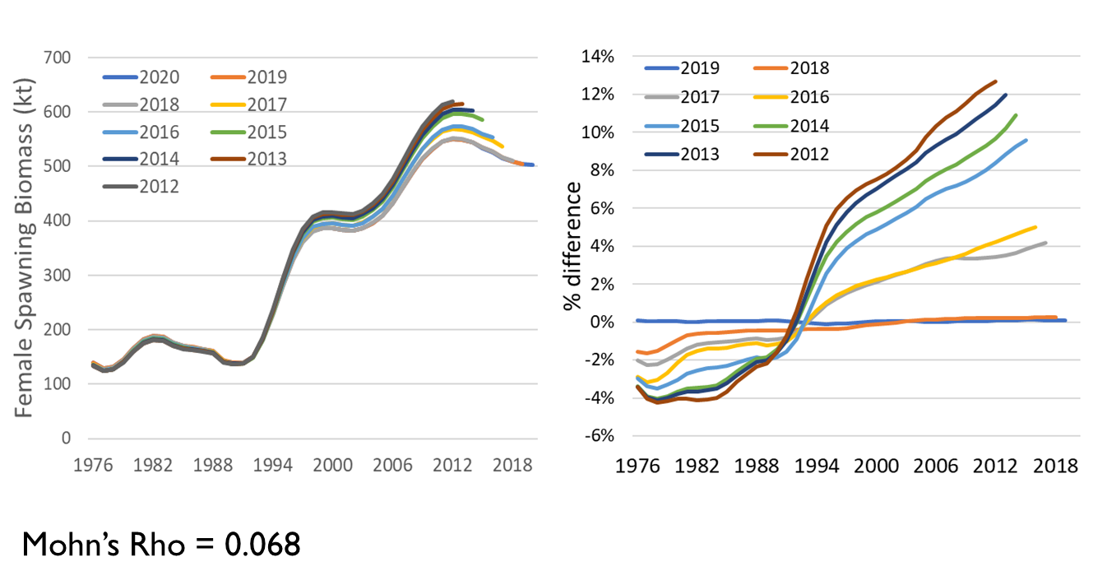
Retrospective
Notes:
Graph of 10 year peel with Mohns rho estimate, if evaluating multiple models include retrospective graph and Mohns rho estimate for base and author recommended model

Slide 30
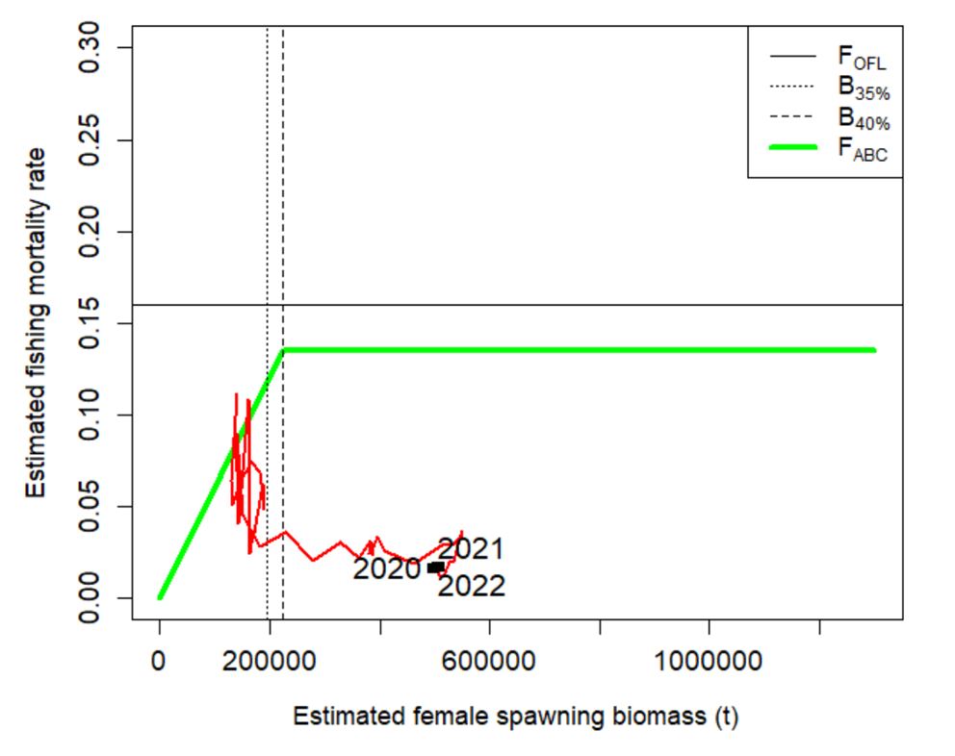
Phase Plane
Notes:
Plot of fishing mortality rate relative to F35% and female spawning biomass relative for B 35% for status

Slide 31
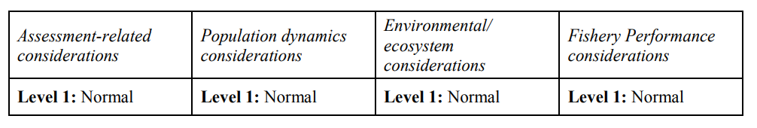
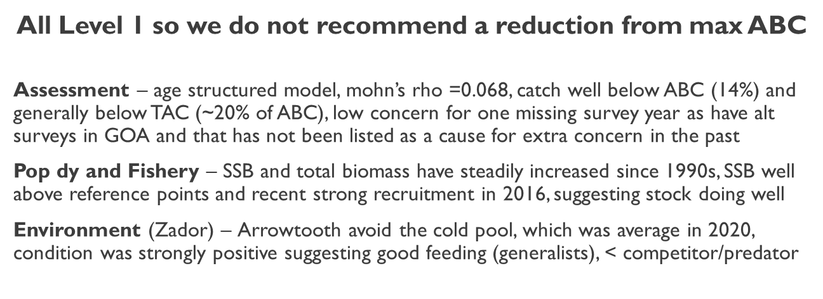
Risk Table
Notes:
Summary table with brief summary of justification text or plots for selected levels of risk, if have ESP for stock and presentation preceding then can simply reference ESP graphs

Slide 32
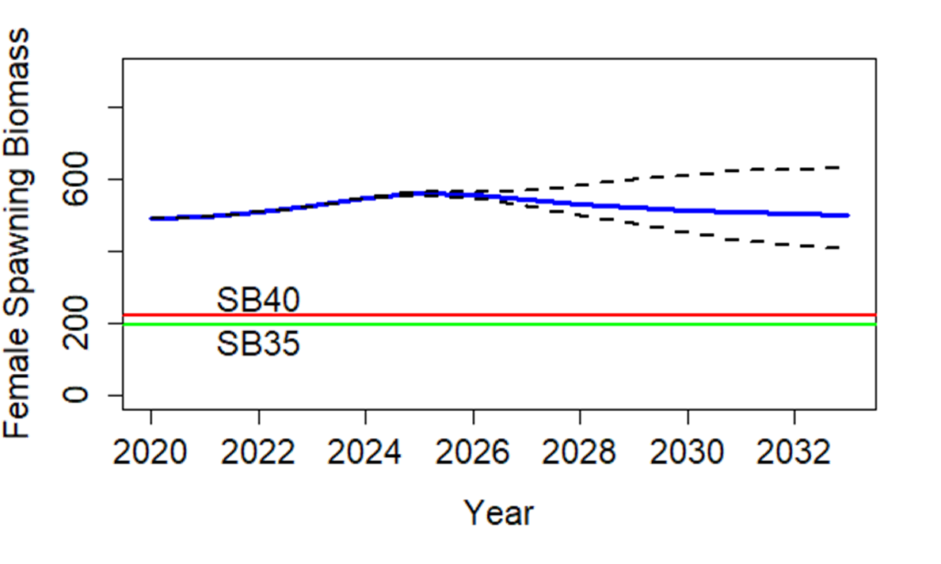
Projection
Notes:
Model graph of Spawning Stock Biomass with B40% and B35% reference lines

Slide 33
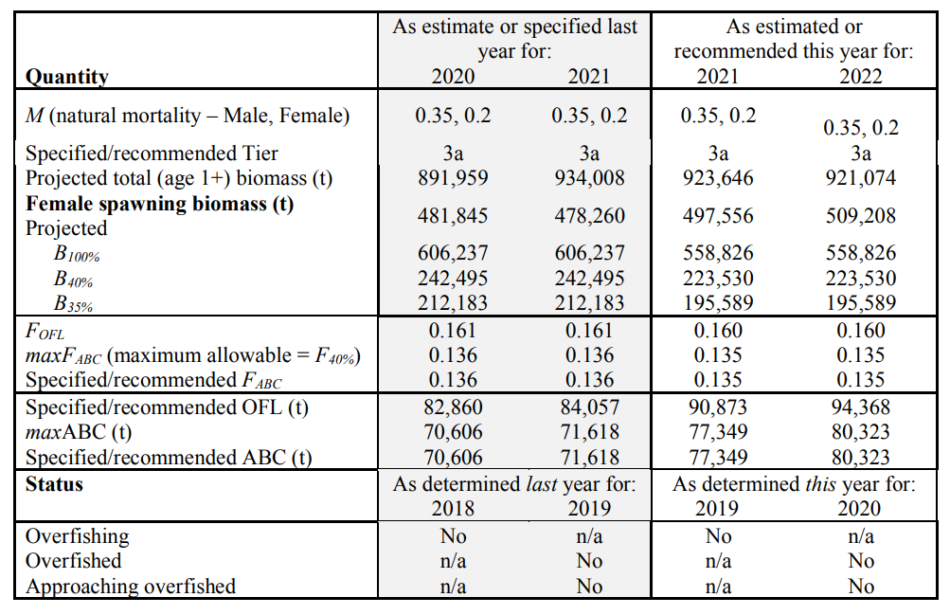
Harvest Recommendation
Notes:
Summary table with last year and recommendation for this year values, highlight ABC and OFL

Slide 34
Apportionment
Table where applicable, including random effects model graphs and final appointment table
Notes:
Table where applicable, including random effects model graphs and final apportionment table

Slide 35
Appendices
List with brief description, if relevant to decision of model provide highlights
Notes:
List with brief description, if relevant to decision of model provide highlights

Slide 36
Conclusions
Recommendation
No model changes, data correction to use fishery sizes from start of observer program with minimum level of samples (300)
Leveling out of biomass after long period of increase from low stock size, possible new year class emerging, surveys show average to increase
No reduction recommended: ABC = … t, OFL = … t
Data Gaps and Future Research Priorities
Consider exploring incorporating estimates of predation mortality from recent EBS CEATTLE model (K. Holsman), include efforts to streamline data pulls and processing between single and multi-species models
Re-examine growth assumptions, update age-length conversion matrices, consider alternative surveys and VAST estimates
Notes:
List of final recommendations with any relevant data gaps and research priorities

Slide 37
Plan Team Summary
Table filled out using author recommended model
Notes:
Table filled out using author recommended model

Slide 38
Discussion
May include list of action questions if applicable for the Teams deliberation
Notes:
May include list of action questions if applicable for the Teams deliberation

Slide 39

QUESTIONS?
CONTACTS:
KALEI.SHOTWELL@NOAA.GOV

Slide 40

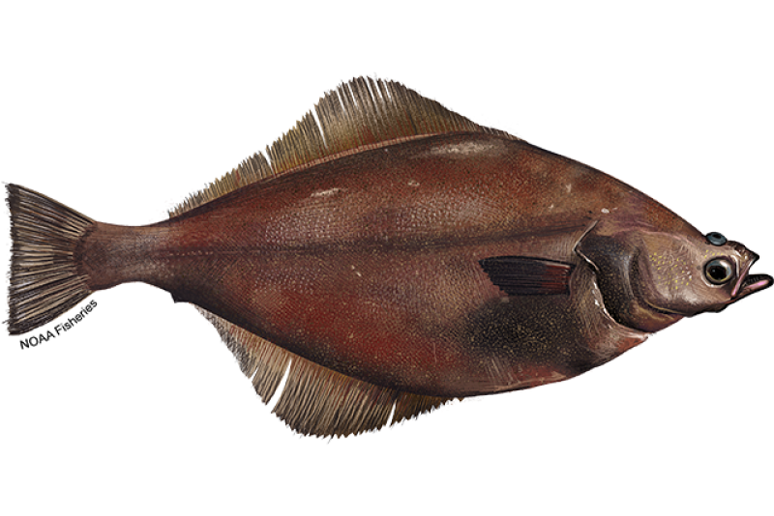
Supplemental Slides for BSAI Plan Team

